Slide 1
Social Simulation:
Repackaging the same old snake oil?
Policy models for consultation and collaboration

Slide 2
The old snake oil
Equation-based
Inspired or constrained by equilibrium concepts
Stochastic
  Requires assumption that probabilities sum to 1
  Implies that all possible outcomes known in advance
Focus on forecasting
  Probably never been a correct forecast of a change
  Probably never been a correct model-based forecast of a policy impact

Slide 3
Acknowledgements
This paper draws heavily on the OCOPOMO Project
OCOPOMO: Open Collaboration and Policy Modelling
The modelling software reported here has been developed
by Ulf Lotzmann of the University of Koblenz with important
elements developed by Ruth Meyer. I contributed the core design
requirements The marking-up software has been developed principally
by Sabrina Scherer of the University of Koblenz.
The overall design of the framework is due to me and to Maria
Wimmer of the University of Koblenz in consultation with members
of the OCOPOMO Project

Slide 4
An alternative to snake oil
Evidence-based
Inspired or constrained by independently well validated principles of behaviour and social interaction
Deterministic but extremely sensitive to initial conditions
Focus on exploring expectations and perceptions of stakeholders

Slide 5
Procedural vs declarative modelling
Procedural modelling
  The process is specified in advance
    Examples are utility and profit maximisation algorithms as descriptions of behaviour
    Process not affected by current state
Declarative modelling
  The process emerges as a consequence of the state
    Examples to follow

Slide 6
Equation-based vs rule-based modelling
Equation-based modelling
  Numerical inputs and outputs
  Inherently qualitative features must be represented numerically
Rule-based modelling
  Allows for both numbers and linguistic terms as inputs and outputs
  Much easier to produce verbal stories as outputs from rule-based simulation models
  Can also produce numerical outputs

Slide 7
Purpose of declarative, rule- and evidence-based models
Precision
Scenario development
  Linking stakeholders’ narratives and simulation model design and outputs.
Exploration of perceptions and expectations of stakeholders
  Assessing plausibility of assumptions in relation to evidence

Slide 8
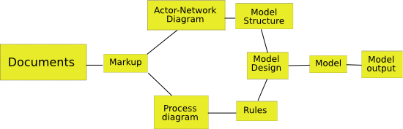
Linking evidence to models to outputs

Slide 9
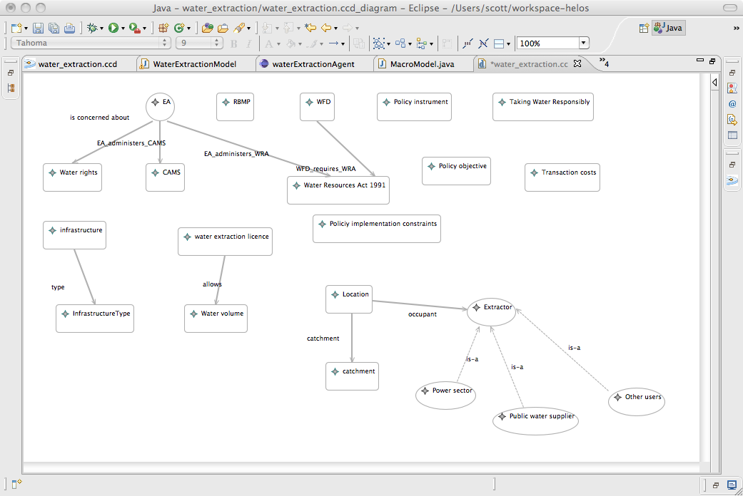
Simple water extraction model
Structure from evidence

Slide 10
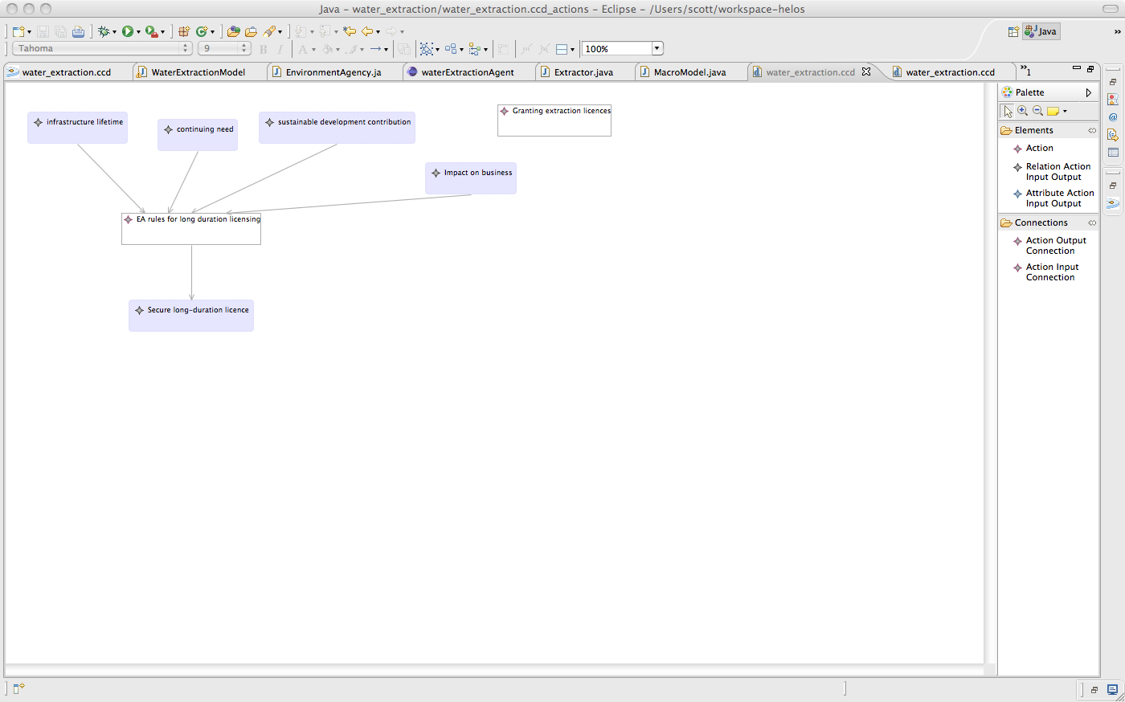
Simple water extraction model:
Process from evidence

Slide 11
Modelling process:
Declarative Rule-based Agent Modelling Software (DRAMS)
Rule-based modelling environment implemented in Java
Integrates with RePast 3.1 now and prospectively any other Java-based modelling environment or, for example, NetLogo
Efficient because rules compiled within a dependency network rather than with a rete algorithm
Conventional rule-based syntax

Slide 12
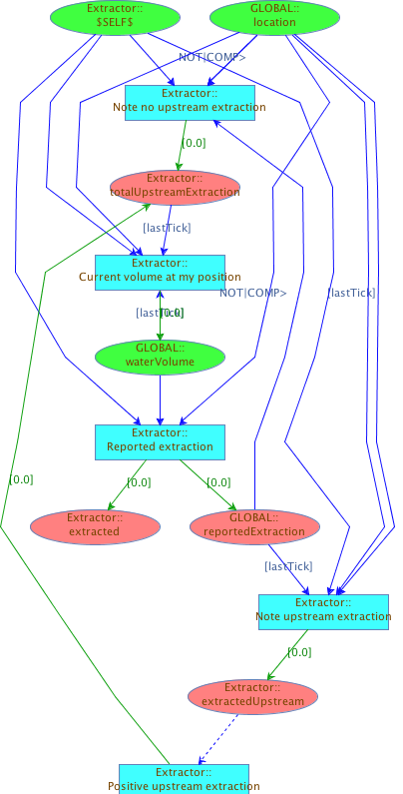
Simple water extraction model:
Data Dependency Graph (DDG)
Green ovals: Initialisation facts and facts asserted directly from Java
Salmon ovals: Facts asserted by rules
Blue lines: Point to rules facts are used in as conditions (on the LHS or “if” part)
Green lines: Point to facts asserted by rules (on the RHS or “then” part)

Slide 13
Should models be simple?
For:
  Simpler models easier to understand
  Simpler models faster to implement in given modelling environment
Against:
  Simplistic
    Lack of nuance in agent behaviour
    More likely to leave out important influences
  Not necessary to understand whole of a complex model
    Sufficient to understand reasons for specific events

Slide 14
A more complicated model
Technology represented by input-output matrix
  Basic commodities enter directly or indirectly into the production of all commodities (square, indecomposable matrix)
  Non-basic commodities are final commodities
Agent classes
  Household – buy non-basics, supply labour
  Firm – buy goods and hire labour to produce goods
  Government – buys final goods, sells bonds
  Bank – buys bonds (creating cash) from Gov & Firms

Slide 15
Agent behaviour
Choice
  Select other agents for economic engagement on basis of ongoing quality of experience
Learn by formulating mental models
  Condition ➔ action ➔ new condition
  Condition is instantiation of facts on fact bases
  Action is assertion of fact to fact base
Choose and evolve mental models on basis of experience
Develop plans in which consequences expected in one model are the initial conditions of another
  Produces a sequence of actions

Slide 16
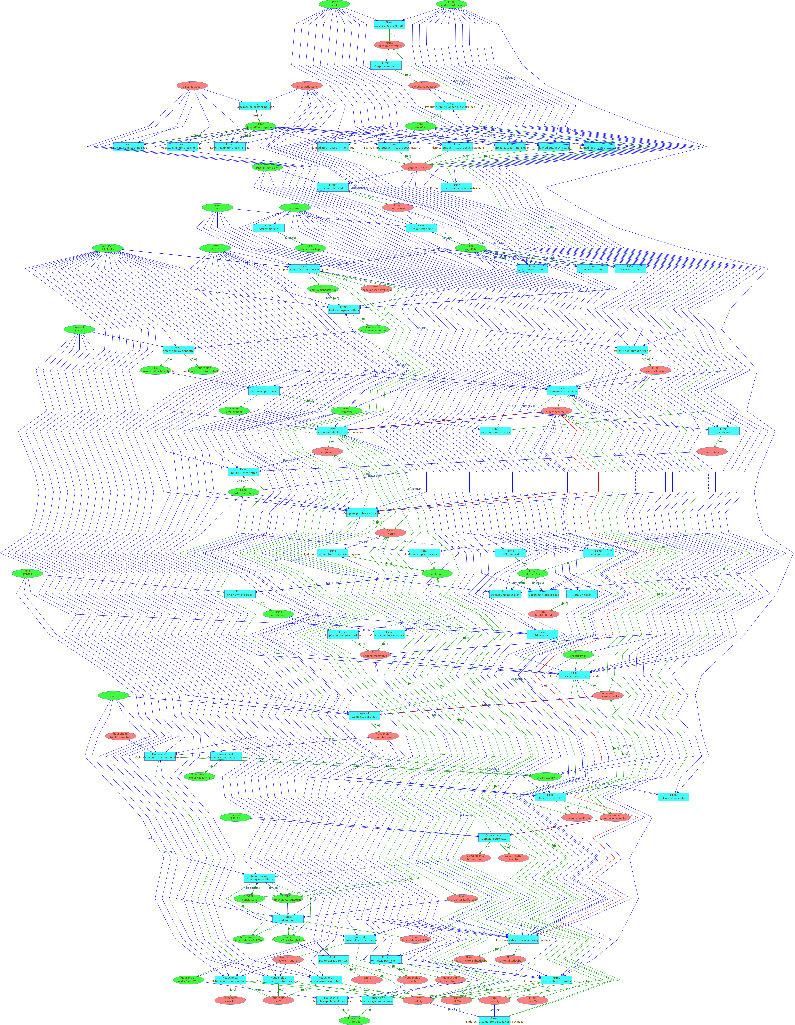
Macro model DDG

Slide 17
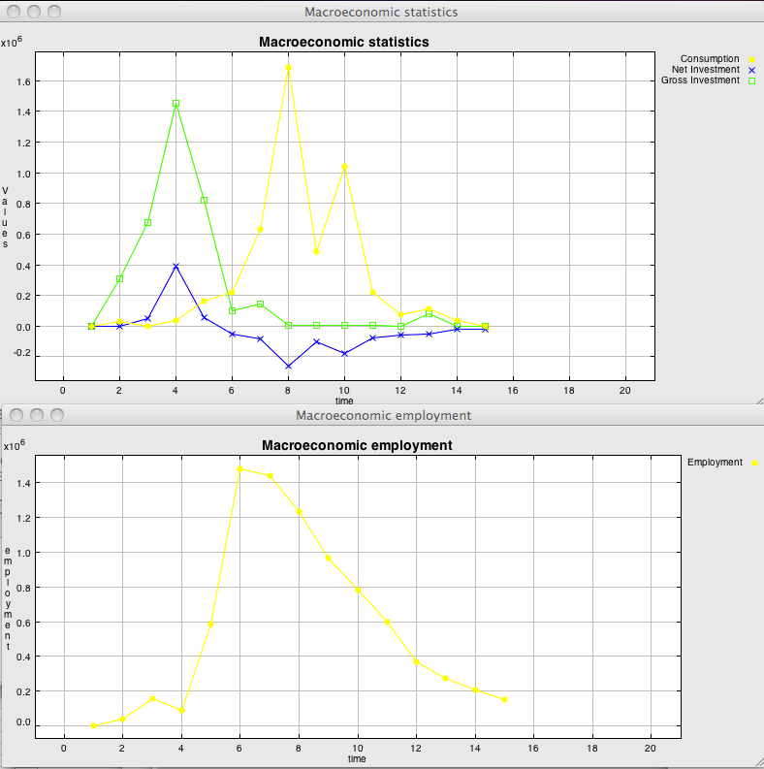
Tracing an event

Slide 18
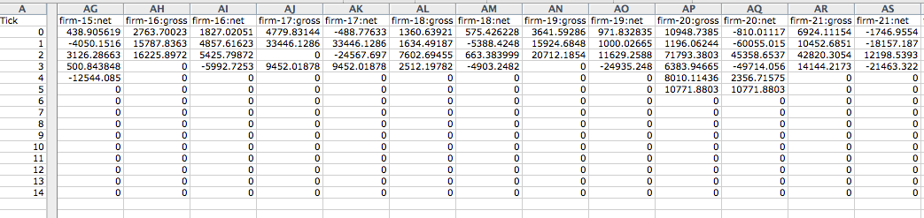
Identify a relevant agent
Firm-19 is an early firm to stop purchases

Slide 19
Excerpt from trace
[firm-19.Excess demands] "There is excess demand for product-6 of 54194.48092335601 units"
[firm-19.Stock output constraint] "Max output with current stock of product-0 is 1913.2645900564034"
[firm-19.Stock output constraint] "Max output with current stock of product-3 is 1638.635111363638"
[firm-19.Stock output constraint] "Max output with current stock of product-7 is 1306.6565872968433"
[firm-19.Planned output with sales] "I produce product-6; Current stock is 3676.6963916716013. Minimum desired stock is 10453.252698374747. Planned output is 9389.869481296832."
[firm-19.Input purchase offer] "Demand for product-3 from supplier firm-3 is 9828.163118306145 at price 32.651660967365814"
[firm-19.Input purchase offer] "Demand for product-7 from supplier firm-33 is 10879.83541773058 at price 145.41519418889393"
[firm-19.Input purchase offer] "Demand for product-0 from supplier firm-39 is 15633.003536422842 at price 27.687020317407416"
[firm-19.Employment offers: insufficient liquidity] "Offer of bond to bank of value 27066.13229537562 to cover wage bill"
[firm-19.Employment offers: insufficient liquidity] "household-5 is offered employment of 27066.13229537562"
[firm-19.Agree employment] "household-5 is now employed for 27066.13229537562 at wage rate 1.0"
[firm-19.Labour output constraint] "Max output with available labour is 9389.869481296832"
[firm-19.Output constraint] "The constrained output is 1306.6565872968433"
[firm-19.Product output: planned > constrained] "Constrained output is 1306.6565872968433; planned output is 9389.869481296832, actual output is 1306.6565872968433"

Slide 20
Link and interpretation
The trace includes links to rules that produced verbal outputs
The story is that orders were placed for inputs to production but were not filled by suppliers. As a result, firm-19 was severely constrained in its output well below planned output level. Excess demands were substantial and could not be met
Implication to be explored: propagation of excess demands causes economy to collapse

Slide 21
Benefits of complicated models
With links from outputs back to documentary evidence we can determine causes for behaviour and whether that behaviour is plausible in relation to evidence
We do not have to infer outcomes from statistical tests but can explore reasons in detail
Better understanding that with simple models focused on issues and specific causes

